Slide 1
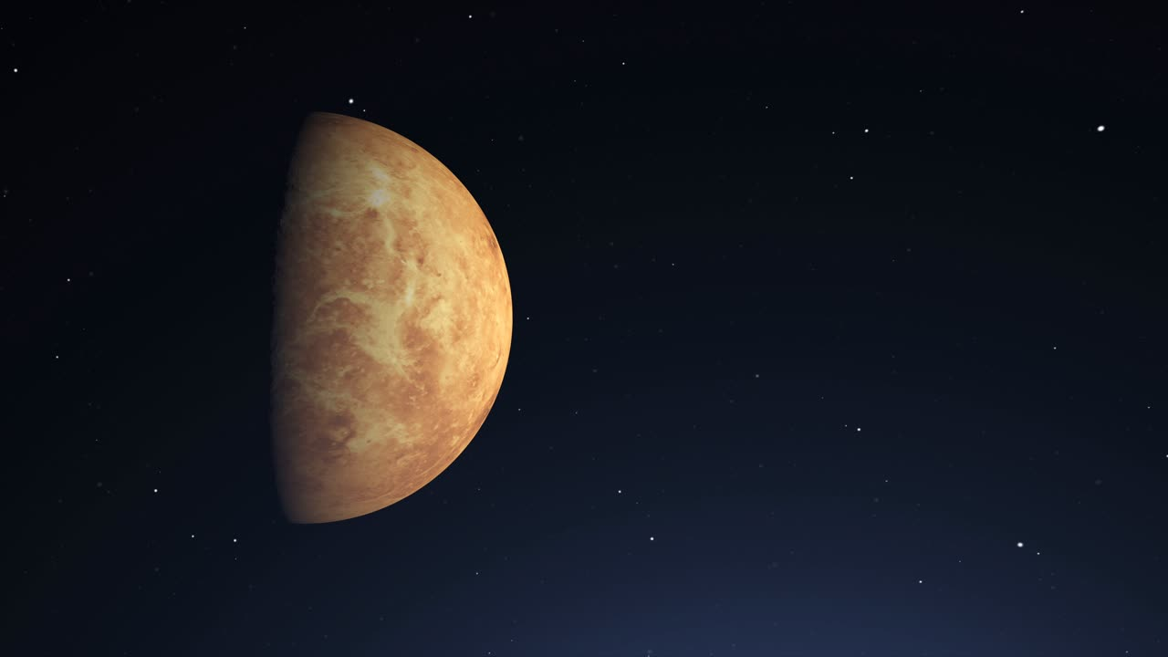
DiD venus had life?
Exploring the proof of life’s possibility on Venus!

Slide 2



VENUS

Slide 3

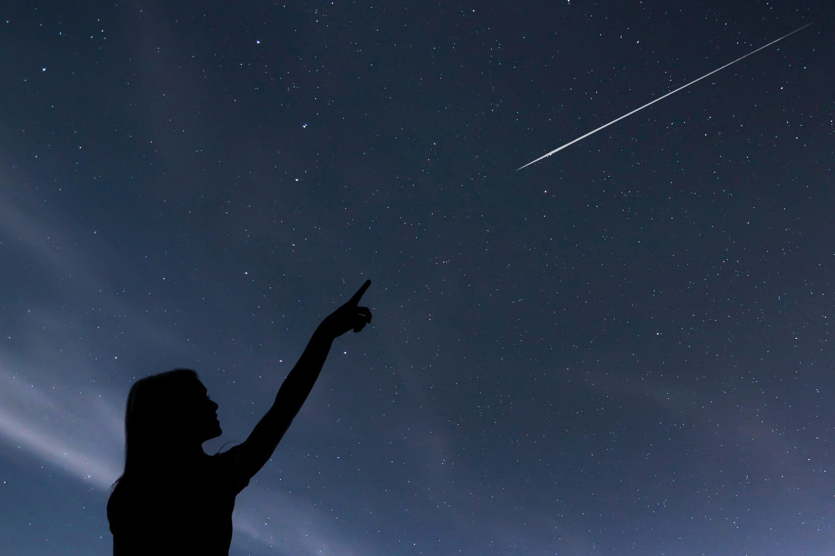
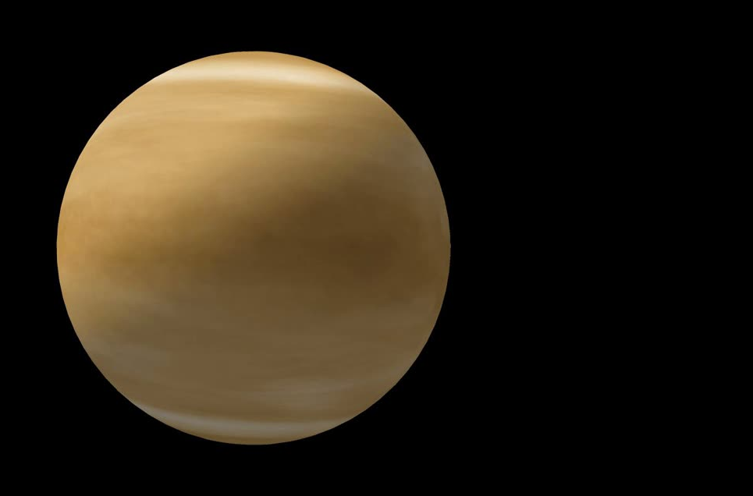
We always thought that this big fireball which even though is a planet, is still called “The Morning Star” because

Slide 4
We always thought that this big fireball which even though is a planet, is still called “The Morning Star” because
. . .

Slide 5
We always thought that this big fireball which even though is a planet, is still called “The Morning Star” because
. . .
It is a Fireball!

Slide 6
We always thought that this big fireball which even though is a planet, is still called “The Morning Star” because
. . .
It is a Fireball!
What?
You don’t see fire?

Slide 7
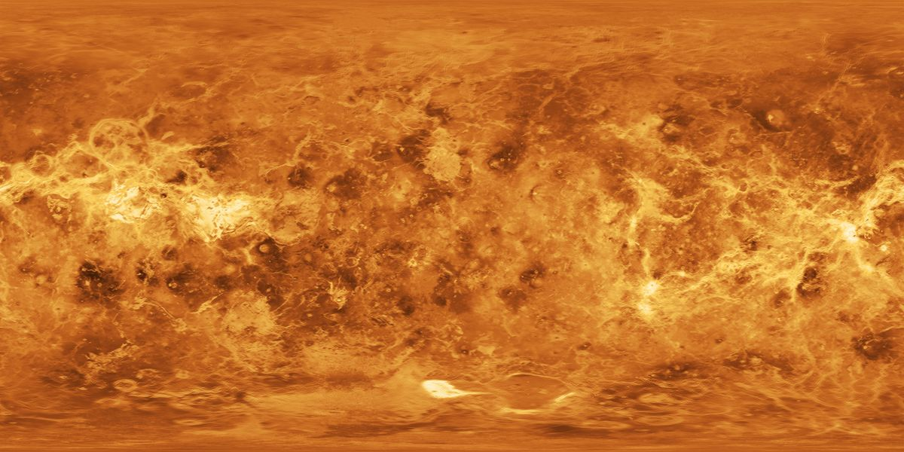
you see it now?

Slide 8
you see it now?
Welcome to the Surface of Venus

Slide 9
you see it now?
Welcome to the Surface of Venus
of Today that is!

Slide 10
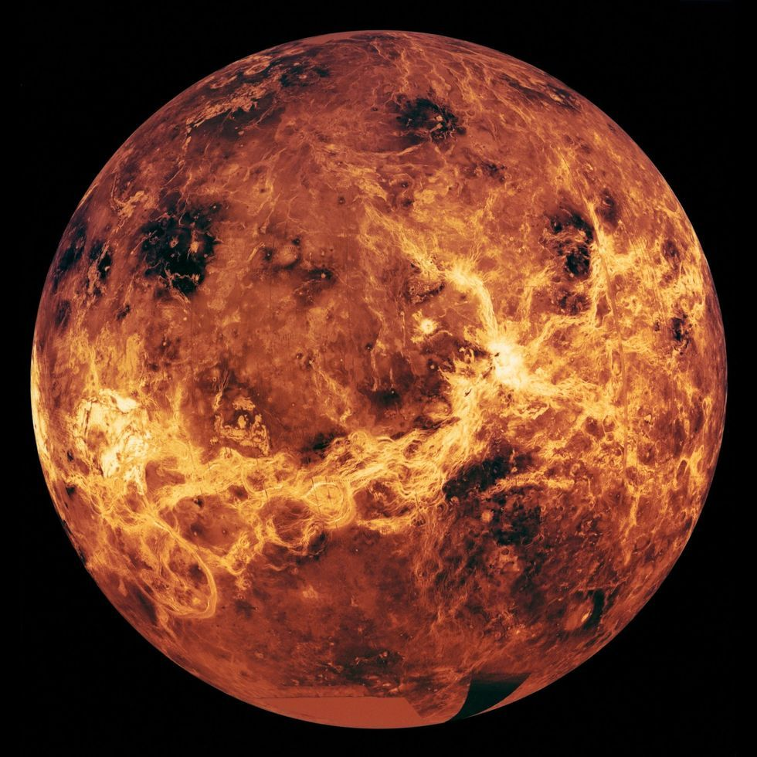
How can someone imagine a life in this hellish place !

Slide 11
How can someone imagine a life in this hellish place !
Well the Scientists can!

Slide 12
How can someone imagine a life in this hellish place !
Well the Scientists can!
And Astronomy Enthusiasts Like Me
can!

Slide 13
So I am one of those people who support the hypothesis that life was present on Venus

Slide 14
So I am one of those people who support the hypothesis that life was present on Venus
EVEN BEFORE EARTH!

Slide 15
So I am one of those people who support the hypothesis that life was present on Venus
EVEN BEFORE EARTH!
And I wanted to put this same hypothesis in front of all through this challenge

Slide 16
BUT THEN

Slide 17
BUT THEN
Life Happened !

Slide 18
I did not find a single dataset that could showcase the data between modern Venus, modern Earth, previous Venus, and previous Earth!

Slide 19
I did not find a single dataset that could showcase the data between modern Venus, modern Earth, previous Venus, and previous Earth!
So
What did I do?

Slide 20
I did not find a single dataset that could showcase the data between modern Venus, modern Earth, previous Venus, and previous Earth!
So
What did I do?
I created one of

Slide 21

I did not find a single dataset that could showcase the data between modern Venus, modern Earth, previous Venus, and previous Earth!
So
What did I do?
My Own
I created one of

Slide 22
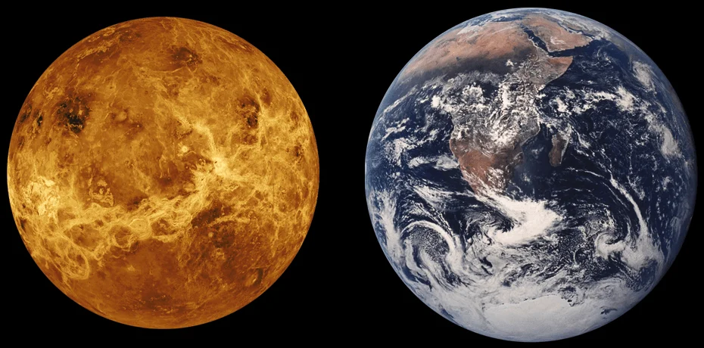
Why called as twins?

Slide 23
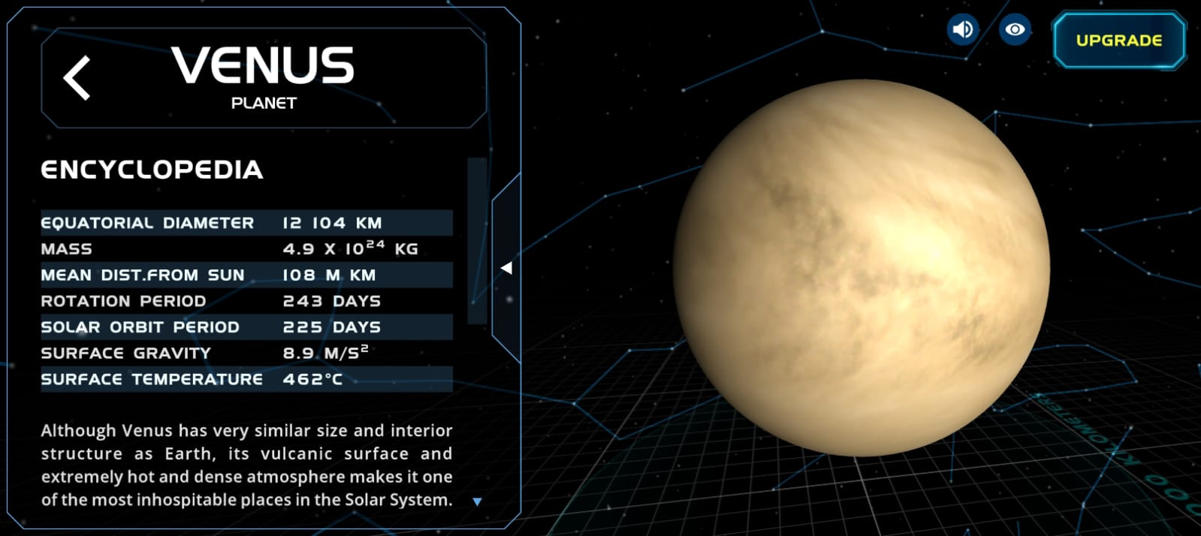

Slide 25
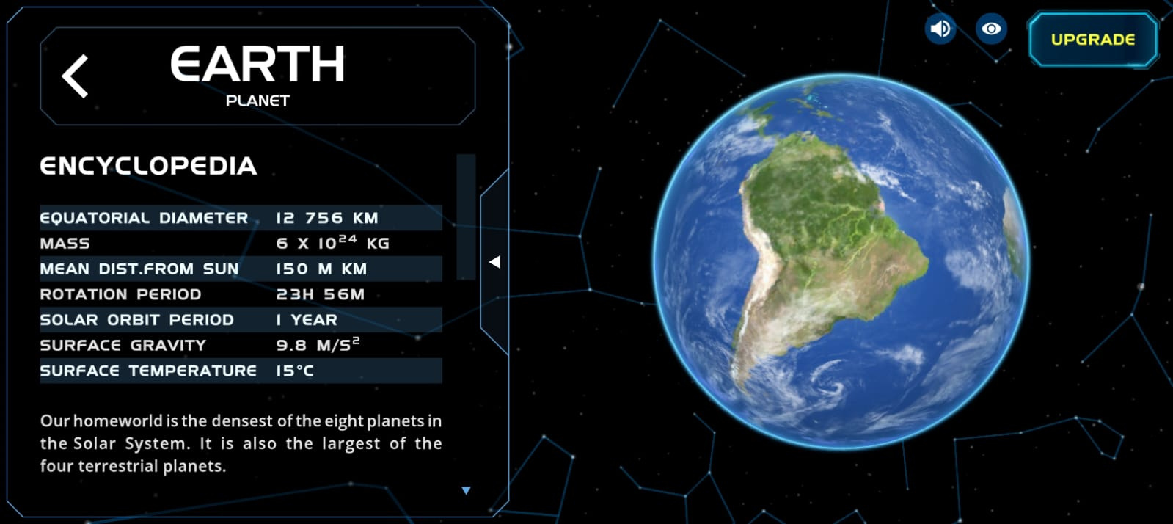

Slide 26
Well, that was the picture of today!

Slide 27
Well, that was the picture of today!
But Before they used to look like this

Slide 28
But Before they used to look like this

Slide 29
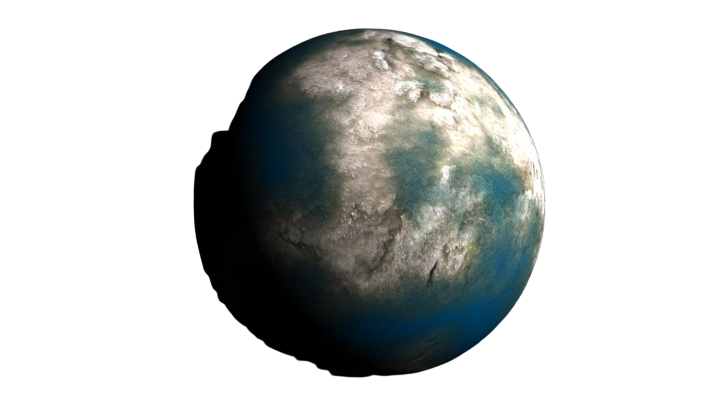
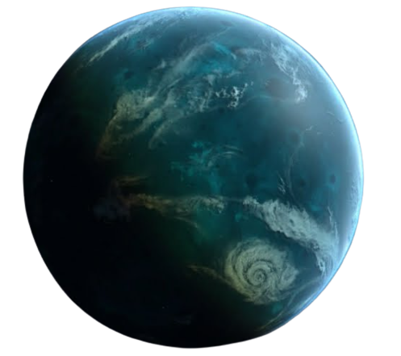
But Before they used to look like this

Slide 30
But Before they used to look like this
Atleast according to simulations!

Slide 32
before’s Venus

Slide 33
before’s Venus

Slide 34
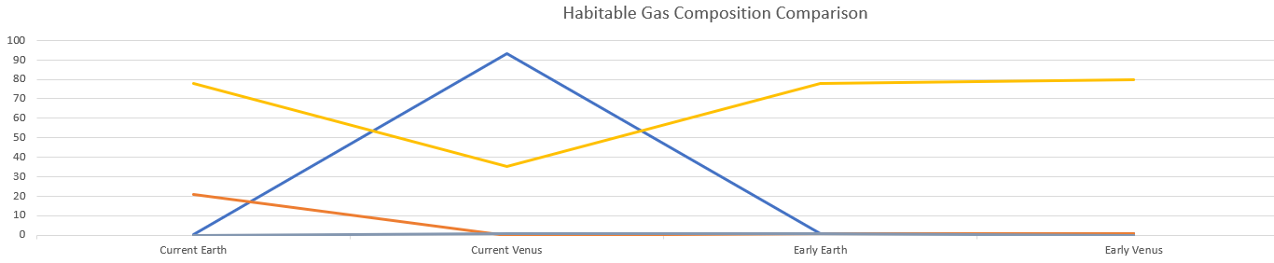
before’s Venus
Before the Gaseous composition of Before’s Venus was almost the same as the before’s Earth!

Slide 35
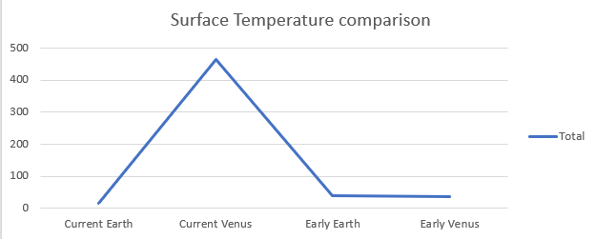
before’s Venus
The surface Temperature before was only very similar. It is considered that Venus used to have liquid oceans like Earth

Slide 36
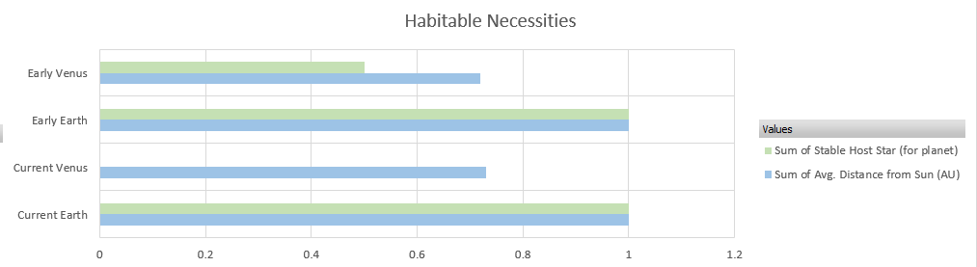
before’s Venus
It is believed that according to the Sun’s early period, the Goldilocks zone also contained Venus along with Earth!

Slide 37
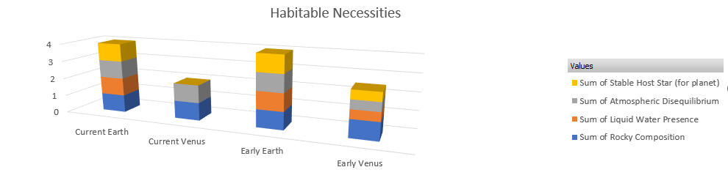
before’s Venus
All the “Habitable Necessities” were present on the Before’s Venus!

Slide 38
So Here i end this story!

Slide 39
So Here i end this story!
Hope it was fun!

